Slide 1
Python Data Structures/Collections
Week 2

Slide 2
Data Structures
List []
Tuple ()
Set {}
Dictionary {}

Slide 3
Python Data Types
Text Type: str
Numeric Types: int, float, complex
Sequence Types: list, tuple, range
Mapping Type: dict
Set Types: set, frozenset
Boolean Type: bool
Binary Types: bytes, bytearray, memoryview

Slide 4
Getting the Data type of a variable
You can get the data type of any object by using the type() function:
x = 5
print(type(x))

Slide 5
Setting Data Types
Example | Data Type
x = "Hello World" | Str
x = 20 | Int
x = 20.5 | Float
x = 1j | Complex
x = ["apple", "banana", "cherry"] | List
x = ("apple", "banana", "cherry") | Tuple
x = range(6) | Range
x = {"name" : "John", "age" : 36} | Dict
x = {"apple", "banana", "cherry"} | Set
x = frozenset({"apple", "banana", "cherry"}) | Frozenset
x = True | Bool
x = b"Hello" | Bytes
x = bytearray(5) | Bytearray
x = memoryview(bytes(5)) | memoryview

Slide 6
Setting the Specific Data Type
Example | Data Type
x = str("Hello World") | Str
x = int(20) | Int
x = float(20.5) | Float
x = complex(1j) | Complex
x = list(("apple", "banana", "cherry")) | List
x = tuple(("apple", "banana", "cherry")) | Tuple
x = range(6) | Range
x = dict(name="John", age=36) | Dict
x = set(("apple", "banana", "cherry")) | Set
x = frozenset(("apple", "banana", "cherry")) | Frozenset
x = bool(5) | Bool
x = bytes(5) | Bytes
x = bytearray(5) | Bytearray
x = memoryview(bytes(5)) | memoryview

Slide 7
Python List

Slide 8
Python List
Used to store multiple items in a single variable.
One of 4 built-in data types in Python used to store collections of data, the other 3 are Tuple, Set, and Dictionary, all with different qualities and usage.
Created using square brackets []

Slide 9
Python List Example
thislist = ["apple", "banana", "cherry"]
print(thislist)

Slide 10
List Items
Ordered, changeable, and allow duplicate values.
Indexed, the first item has index [0], the second item has index [1] etc.

Slide 11
Ordered List
The items have a defined order, and that order will not change.
If you add new items to a list, the new items will be placed at the end of the list.

Slide 12
Changeable List
Meaning that we can change, add, and remove items in a list after it has been created.

Slide 13
List Duplicates
Since lists are indexed, lists can have items with the same value.

Slide 14
List Length
To determine how many items a list has, use the len() function:
thislist = [“Rogers", “Black Widow", “Thanos"]
print(len(thislist))

Slide 15
List Items in different Data Types
list1 = [“A", “B", “C"] #String
list2 = [1, 5, 7, 95, 420] #Integeter
list3 = [True, False, False] #Boolean

Slide 16
List can include different data types
list = [“AbC", 34, True, 4055, “MALE"]
“AbC” and “MALE” are strings
34 and 4055 are an integers
True is Boolean

Slide 17
Data Type of a List
From Python's perspective, lists are defined as objects with the data type 'list’:
type() function can be used to identify its data type or class.
myCharacters = [“Mario", “Luigi", “Goomba"]
print(type(myCharacters))
Output: <class 'list'>

Slide 18
The list() Constructor
It is also possible to use the list() constructor when creating a new list.
scientists = list((“Einstein", “Schrodinger", “LeCun"))
#note it has double round-brackets because it's using a function that is a constructor.
print(scientists)

Slide 19
Python List Reminder
REMEMBER:
A list is ordered, changeable, and allows duplicate members.

Slide 20
Python Tuples

Slide 21
Python Tuples
Used to store multiple items in a single variable.
Used to store collections of data, the other 3 are List, Set, and Dictionary, all with different qualities and usage.
A collection which is ordered and unchangeable.
Written with round brackets ().

Slide 22
Python Tuple Example
thistuple = ("apple", "banana", "cherry") #Round brackets are used.
print(thistuple)

Slide 23
Tuple Items
Ordered, unchangeable, but allow duplicate values.
Indexed, the first item has index [0], the second item has index [1] etc.

Slide 24
Tuple Length
To determine how many items a tuple has, use the len() function:
divas = (“Nikki", “Sasha", “Trish")
print(len(divas))
Remember print() is a function in Python ☺

Slide 25
Create a Tuple With One Item
To create a tuple with only one item, you must add a comma after the item, otherwise Python will not recognize it as a tuple.
thistuple = ("apple",)
print(type(thistuple))
Output: <class 'tuple'>
#NOT a tuple
thistuple = ("apple") #no comma “ , ” found.
print(type(thistuple))
Output: <class 'str’>
As you can see, the output is NOT A TUPLE. Rather, it’s a STRING!
BE CAREFUL!!

Slide 26
Tuple Items - Data Types
Tuple items can be of any data type:
tuple1 = ("apple", “B", “CCC") #string
tuple2 = (1, 5, 7, 9, 3) #integer
tuple3 = (True, False, False) #boolean

Slide 27
Multiple Data Types in a Tuple
A tuple can also contain different data types:
tuple1 = ("abc", 34, True, 40, "male") #remember TUPLES uses rounded brackets ()
What are the existing data types in tuple1?
What are the data types of each item?

Slide 28
Data Type of a Tuple
From Python's perspective, tuples are defined as objects with the data type 'tuple’:
type() function can be used to identify its data type or class.
thistuple = ("apple", "banana", "cherry“)
print(type(thistuple))
Output: <class tuple'>

Slide 29
The tuple() Constructor
It is also possible to use the tuple() constructor to make a tuple.
thistuple = tuple(("apple", "banana", "cherry")) #note the double round-brackets are used for TUPLES.
print(thistuple)

Slide 30
Python Sets

Slide 31
Python Set
Used to store multiple items in a single variable.
Used to store collections of data, the other 3 are List, Tuple, and Dictionary, all with different qualities and usage.
A collection which is unordered, unchangeable*, and unindexed.
Sets are written with curly brackets {}.
Duplicates Not Allowed in Sets
* Note: Set items are unchangeable, but you can remove items and add new items.
Once a set is created, you cannot change its items, but you can remove items and add new items.

Slide 32
Creating a Python Set
keyboards = {“Feker", “Keychron", “QuertyKeys"}
print(keyboards)

Slide 33
Set Length
microphones = {“Shure", “Rode", “Electro-Voice"}
print(len(microphones))
What function was used to print the length of the set?
What is the length of the set, “microphones”?

Slide 34
Set Items - Data Types
set1 = {"apple", "banana", "cherry"}
set2 = {1, 5, 7, 9, 3}
set3 = {True, False, False}
A set can contain different data types
mixedset = {"abc", 34, True, 40, "male"}

Slide 35
Set’s Data Type
From Python's perspective, sets are defined as objects with the data type 'set':
myset = {"apple", "banana", "cherry"}
print(type(myset))
Output: <class 'set'>

Slide 36
The set() Constructor
It is also possible to use the set() constructor to make a set.
thisset = set(("apple", "banana", "cherry"))
print(thisset)

Slide 37
Python Dicitionaries

Slide 38
Dictionary
Used to store data values in key:value pairs.
A collection which is ordered (see next slide), changeable and do not allow duplicates.
Written with curly brackets {} and have keys and values.
This is the same as the JSON format.
thisdict = {
"brand": "Ford",
"model": "Mustang",
"year": 1964}
print(thisdict)

Slide 39
Are Dictionaries Ordered or Unordered?
As of Python version 3.7, dictionaries are ordered. In Python 3.6 and earlier, dictionaries are unordered.
If dictionaries are ordered, it means that the items have a defined order, and that order will not change.
If Unordered, it means that the items does not have a defined order, you cannot refer to an item by using an index.

Slide 40
Dictionary Example
Print the "brand" value of the dictionary
An item in the dictionary can be selected by having the dictionary with square brackets [] with a specific item inside quotations “item”.
thisdict = {
"brand": "Ford",
"model": "Mustang",
"year": 1964}
print(thisdict["brand"])

Slide 41
Dictionary Length
To determine how many items a dictionary has, use the len() function:
print(len(thisdict))

Slide 42
Dictionary Items - Data Types
The values in dictionary items can be of any data type.
Example of a dictionary with String, int, boolean, and list data types:
thisdict = {
"brand": "Ford",
"electric": False,
"year": 1964,
"colors": ["red", "white", "blue"]}

Slide 43
Dictionary’s Data Type
From Python's perspective, dictionaries are defined as objects with the data type 'dict’:
thisdict = {
"brand": "Ford",
"model": "Mustang",
"year": 1964}
print(type(thisdict))
Output: <class 'dict’>
Reminder type() is a function that returns the data type ☺

Slide 44
Data Types Cheat Sheet

Slide 45
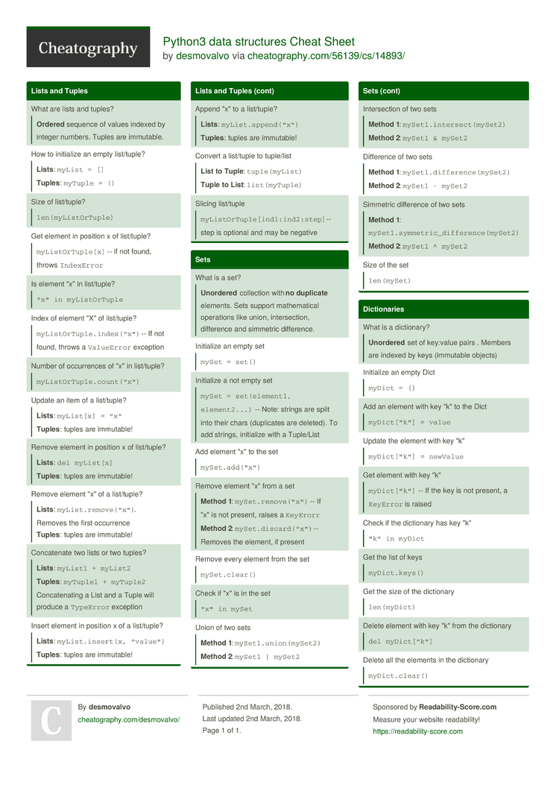
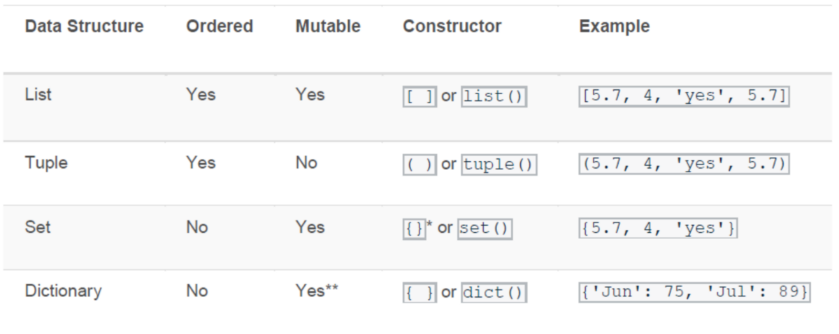
Cheat Sheets

Slide 46
Data/Item Manipulation with Python

Slide 47
Item Manipulation in a List, Tuple, Set, and Dictionary
Accessing
Adding
Changing
Removing
Looping
Listing
Sorting
Copying
Joining

Slide 48
Accessing List and Tuples

Slide 49
Accessing List and Tuple Items
List and Tuple items are indexed, and you can access them by referring to the index number inside square brackets []:
myitems = ["apple", "banana", "cherry"]
print(myitems[1])
Output: banana

Slide 50
Accessing List and Tuple Items
You can specify a range of indexes by specifying where to start and where to end the range.
When specifying a range, the return value will be a new list with the specified items.
Note: The search will start at index 2 (included) and end at index 5 (not included).
Remember that the first item has index 0.
myitems = ["apple", "banana", "cherry", "orange", "kiwi", "melon", "mango"]
print(myitems[2:5])
Output: ['cherry', 'orange', 'kiwi']

Slide 51
Accessing List and Tuple Items
This example returns the items from the beginning to, but NOT INCLUDING, "kiwi":
myitems = ["apple", "banana", "cherry", "orange", "kiwi", "melon", "mango"]
print(myitems[:4])
Output: ['apple', 'banana', 'cherry', 'orange’]
Tip: You can get the length of “myitems” by using len() to determine which part of it you want to access or manipulate.
print(len(myitems)) #this will output a 7, which if referring to index its 0-6
How will you access the first up to third item “cherry”?
If you want to start from the second item, simply put an index value of that item. If Starting from “banana”, the use 1.
Therefore, having print(myitems[1:4])
0
1
2
3
4
5
6
← Index values
Length = 7

Slide 52
Accessing List and Tuple Items
myitems = ["apple", "banana", "cherry", "orange", "kiwi", "melon", "mango"]
print(myitems[2:])
Looking at the example, what do you think is the output?
Clues:
The first value [first:second] INCLUDES that item.
Leaving it blank takes in all.

Slide 53
Accessing List and Tuple Items
The items within the list and tuples can be accessed using the Negative Indexing method.
Negative indexing means start from the end.
-1 refers to the last item, -2 refers to the second last item etc.
myitems = ("apple", "banana", "cherry")
print(myitems[-1])
Output: cherry
Note: Anything >-3 will raise an error “IndexError: tuple index out of range”
-3
-2
-1

Slide 54
Accessing List and Tuple Items
You can also specify negative indexes if you want to start the search from the end of the list:
myitems = ["apple", "banana", "cherry", "orange", "kiwi", "melon", "mango"]
print(myitems[-4:-1])
What do you think is the output?
Clues: First key value is included, and last key value indicates the last but is not included.
Tip:
You can take the length of “myitems” and invert them negatively. Once negative indexes are identified you can use them as basis.

Slide 55
Accessing List and Tuple Items
Checking items within the list or tuple for sanity checking.
Using an if statement is a practical method.
To determine if a specified item is present in a list use the in keyword:
Check if "apple" is present in the list:
myitems = ["apple", "banana", "cherry"]
if "apple" in myitems :
print("Yes, 'apple' is in the fruits list")
Output: Yes, 'apple' is in the fruits list
What if "apple" is removed or replaced? Will there be an error? No, there will be no error. It will simply not output nothing. Unless an else statement is provided.

Slide 56
Accessing List and Tuple Items
# example list
fruits = ['apple', 'banana', 'cherry', 'date', 'elderberry']
# access every second element in the list
print(fruits[::2])
# Output: ['apple', 'cherry', 'elderberry']
# example tuple
numbers = (1, 2, 3, 4, 5, 6, 7, 8, 9, 10)
# access every third element in the tuple
print(numbers[::3])
# Output: (1, 4, 7, 10)
Explanation:
The [start:end:step] syntax is used to access elements in a list or tuple.
The first colon : indicates that we want to access elements from the start to the end of the list/tuple.
The second colon : indicates that we want to access all elements by default.
The third colon :step specifies the step value. In the above examples, the step value is 2 for the list and 3 for the tuple, meaning we want to access every second and third element respectively.

Slide 57
Accessing Set Items

Slide 58
Accessing Set items
You CANNOT ACCESS items in a SET by referring to an index or a key.
But you can loop through the set items using a for loop or ask if a specified value is present in a set, by using the in keyword.
thisset = {"apple", "banana", "cherry"}
for x in thisset:
print(x)
Output:
banana
cherry
apple

Slide 59
Accessing Set items
You can also check if "banana" is present in the set through this method:
thisset = {"apple", "banana", "cherry"}
print("banana" in thisset)

Slide 60
Accessing Dictionary Items

Slide 61
Accessing Dictionary Items
You can access the items of a dictionary by referring to its key name, inside square brackets []:
thisdict = {
"brand": "Ford",
"model": "Mustang",
"year": 1964}
x = thisdict["model"]

Slide 62
Accessing Dictionary Items
Another method to access the key values can be done by using the get() method or function will return a list of all the keys in the dictionary.
thisdict = {
"brand": "Ford",
"model": "Mustang",
"year": 1964}
x = thisdict.get(“model”)
Output: Mustang

Slide 63
Accessing Dictionary Items
To access the keys, using the keys() method or function will return a list of all the keys in the dictionary.
thisdict = {
"brand": "Ford",
"model": "Mustang",
"year": 1964}
x = thisdict.keys()
Output: dict_keys(['brand', 'model', 'year'])

Slide 64
Accessing Dictionary Items
The list of the keys is a view of the dictionary, meaning that any changes done to the dictionary will be reflected in the keys list.
Add a new item to the original dictionary, and see that the keys list gets updated as well:
car = {"brand": "Ford",
"model": "Mustang",
"year": 1964}
x = car.keys()
print(x) #before the change
Output: dict_keys(['brand', 'model', 'year'])
car["color"] = "white"
print(x) #after the change
Output: dict_keys(['brand', 'model', 'year', 'color'])

Slide 65
Changing items in a List

Slide 66
Changing Items in a List
To change the value of a specific item, refer to the index number using square brackets []:
thislist = ["apple", "banana", "cherry"]
thislist[1] = "blackcurrant“ #this will replace banana
print(thislist) #the output should have no banana instead, blackcurrant.
Output: ['apple', 'blackcurrant', 'cherry']

Slide 67
Changing Items in a List
Change the values "banana" and "cherry" with the item values "blackcurrant" and "watermelon":
thislist = ["apple", "banana", "cherry", "orange", "kiwi", "mango"]
thislist[1:3] = ["blackcurrant", "watermelon"]
print(thislist)
Output: ['apple', 'blackcurrant', 'watermelon', 'orange', 'kiwi', 'mango']

Slide 68
Changing Items in a List
Change the second value by replacing it with two new values:
thislist = ["apple", "banana", "cherry"]
thislist[1:2] = ["blackcurrant", "watermelon"]
print(thislist)
Output: ['apple', 'blackcurrant', 'watermelon', 'cherry']

Slide 69
Changing Items in a List
Change the second and third value by replacing it with one value:
thislist = ["apple", "banana", "cherry"]
thislist[1:3] = ["watermelon"]
print(thislist)
Output: ['apple', 'watermelon’]
If [1:2] then it will output ['apple', 'watermelon', 'cherry’] #replaces “banana” cause its 2
If [2:1] then it will output ['apple', 'banana', 'watermelon', 'cherry’] #adds watermelon in 3
If [2:2] then it will output ['apple', 'banana', 'watermelon', 'cherry’] # adds watermelon in 3
If [2:3] then it will output ['apple', 'banana', 'watermelon’] #replaces “cherry cause its 3
If [3:3] then it will output ['apple', 'banana', 'cherry', 'watermelon’] #adds watermelon at the end
Even if you increase y in [3:y], it will always just add watermelon at the end.
If x in [x:y] gets a value > the current index items (which is 3) being added it will just place the new value at the end.
Even If you try [25:3] then it will output ['apple', 'banana', 'watermelon’] #replaces “cherry cause its 3
#THIS IS NONSENSE AND ILLOGICAL TO DO

Slide 70
Changing Items in a List
Simple technique
[x:y] read this as from x to y
Replace the values y^{n} ….. y^{n-1} within the list.
If x is 1 and y is 3, we have [1:3]
Take values from 1 to 3
Replace values 3, 2, EXCEPT 1. Include 1.

Slide 71
Changing Items in a List
Technique application
Example:
thislist = ["apple", "banana", "cherry"]
thislist[1:2] = ["blackcurrant", "watermelon"]
print(thislist)
Solution:
If x is 1 and y is 2, we have [1:2]
Our list is ["apple", "banana", "cherry"]
Replace value 2 which is “banana” with ["blackcurrant", "watermelon"], EXCEPT 1. Include 1. Value 3 is untouched.
Answer: ["apple", "blackcurrant", "watermelon", "cherry"]

Slide 72
Changing Items in a List
Try the technique!
thislist = ["apple", "banana", "cherry", "orange", "kiwi", "mango"]
thislist[1:3] = ["blackcurrant", "watermelon"]
print(thislist)
Output: ['apple', 'blackcurrant', 'watermelon', 'orange', 'kiwi', 'mango’]
The 3 and 2 values are replaced but 1 value kept and the rest in indexes >3 intact.

Slide 73
Changing Items in a List
Insert "watermelon" as the third item using the insert() function:
thislist = ["apple", "banana", "cherry"]
thislist.insert(2, "watermelon")
print(thislist)
Output: ['apple', 'banana', 'watermelon', 'cherry']

Slide 74
Changing/Updating items in a Tuple

Slide 75
Updating items in a Tuple
Once a tuple is created, you cannot change its items! However, there is work around. Therefore, we refer to it as UPDATING rather than CHANGING.

Slide 76
Updating values in Tuples
Once a tuple is created, you cannot change its values.
Tuples are unchangeable, or immutable as it also is called.
But there is a workaround. You can convert the tuple into a list, change the list, and convert the list back into a tuple.
Tuple → Convert to List → Edit the List → Covert back to Tuple
x = ("apple", "banana", "cherry")
y = list(x)
y[1] = "kiwi"
x = tuple(y)
print(x)
What is the output?

Slide 77
Updating values in Tuples
Removing items in tuples is possible through a workaround.
Convert the tuple into a list by passing the tuple into the list() function. From there, remove "apple“ using the remove() function, and convert it back into a tuple using the tuple() function:
thistuple = ("apple", "banana", "cherry")
y = list(thistuple) #assigns the list version of the tuple to another to prevent overriding the “thistuple” tuple.
y.remove("apple") #removes the “apple” item in the list y. Remember, you can remove items in a list not a tuple.
thistuple = tuple(y) #re-assigns the updated tuple converted list to variable “thistuple”

Slide 78
Changing Items in a Dictionary

Slide 79
Changing Items in a Dictionary
You can change the value of a specific item by referring to its key name:
thisdict = {
"brand": "Ford",
"model": "Mustang",
"year": 1964}
thisdict["year"] = 2018
print(thisdict)
Output: {'brand': 'Ford', 'model': 'Mustang', 'year': 2018}

Slide 80
Adding Items in a List

Slide 81
Adding Items in a List
To add an item to the end of the list, use the append() method:
thislist = ["apple", "banana", "cherry"]
thislist.append("orange")
print(thislist)
Output: ['apple', 'banana', 'cherry', 'orange']

Slide 82
Adding Items in a Tuple

Slide 83
Adding Items in a Tuple
Again, tuples are unchangeable, or immutable as it also is called.
What can you do to add entries in a Tuple? Is it possible?
Yes, there is a workaround!

Slide 84
Adding Items in a Set
Once a set is created, you cannot change its items, BUT you CAN ADD new items.
To add one item to a set, use the add() method.
thisset = {"apple", "banana", "cherry"}
thisset.add("orange")
print(thisset)
What is the output?

Slide 85
Adding Items in a Dictionary

Slide 86
Adding Items in a Dictionary
Adding an item to the dictionary is done by using a new index key and assigning a value to it:
thisdict = {
"brand": "Ford",
"model": "Mustang",
"year": 1964}
thisdict["color"] = "red“
print(thisdict)
Output: {'brand': 'Ford', 'model': 'Mustang', 'year': 1964, 'color': 'red'}

Slide 87
Updating Items in a Dictionary
Updating an item to the dictionary is done by using a new index key and using the .update() method:
#Combining directories using update method.
# Initialize the first dictionary
x= {'name': 'Link', 'race': 'Hylian', 'weapon': 'Master Sword'}
# Initialize the second dictionary
y= {'item': 'Bombs', 'item2': 'Bow'}
# Update the first dictionary with the second dictionary
x.update(y)
# Print the updated dictionary
print(x)
{'name': 'Link', 'race': 'Hylian', 'weapon': 'Master Sword', 'item': 'Bombs', 'item2': 'Bow'}

Slide 88
Removing items in a List
The remove() method removes the specified item.
thislist = ["apple", "banana", "cherry"]
thislist.remove("banana")
print(thislist)

